Slide 1

Sadikul Haque Sadi
BSSE 1003

Slide 2
Company Overview
Founded in 1999
Outsourcing based software developing entity
Provides global software solution
35-40 developers

Slide 3
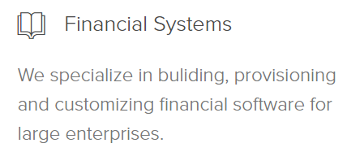
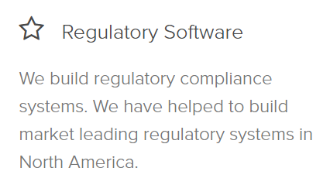
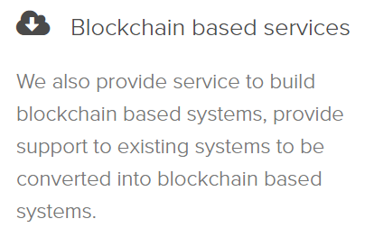
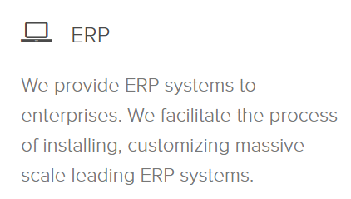
Company Overview

Slide 4
Company Overview

Slide 5
Working Experience
Online Office
Flexible working hour
No restricted deadlines
Friendly and Co-operative
Appreciation & Gratitude

Slide 6

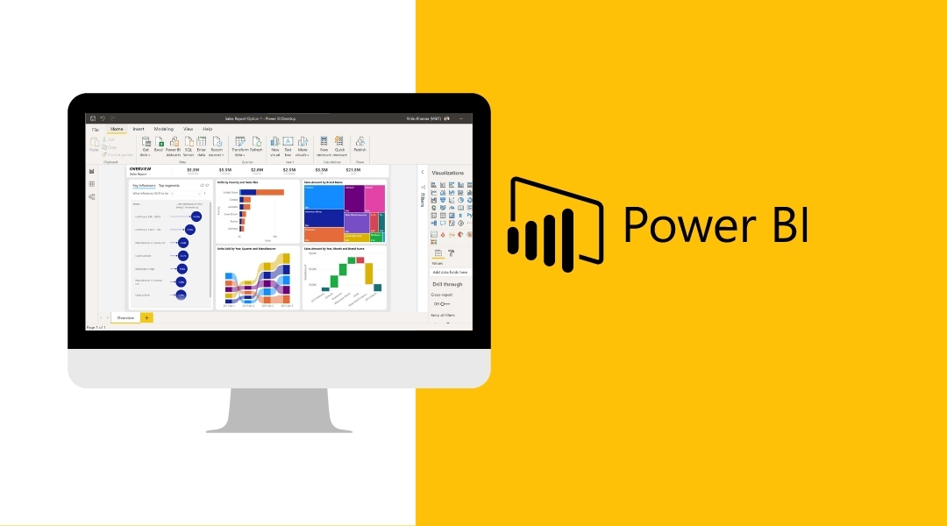
Technology

Slide 7

What is Power BI?
A data analytics tool
Data modeling & Visualizing tool
Report building utility

Slide 8
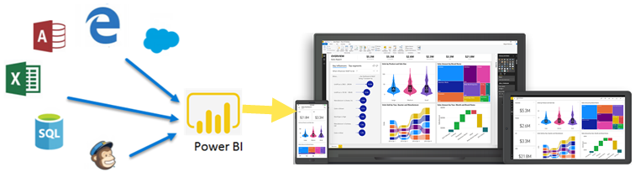
Power BI

Slide 9
Power BI
500+ connectors
Prepare data
Create report & Share

Slide 10


Power BI
No Projects
R & D Work

Slide 11

Power BI
Learning phase
Dealing with data from different sources
R & D Work
Power Query
Data Visuals: Charts, Graphs, Maps etc.

Slide 12

Data Transformation
User Interface
DAX (Data Analysis Expression)
M formula language

Slide 13
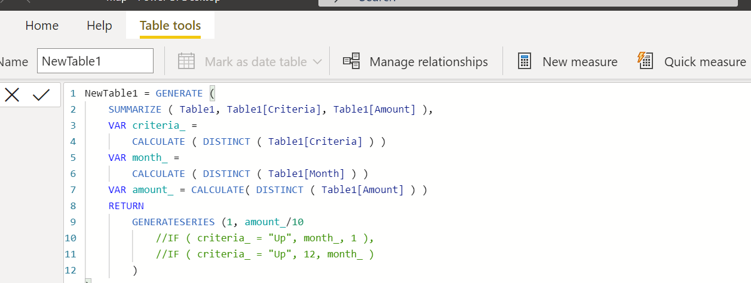
Data Transformation
DAX -
Data Analysis Expression

Slide 14
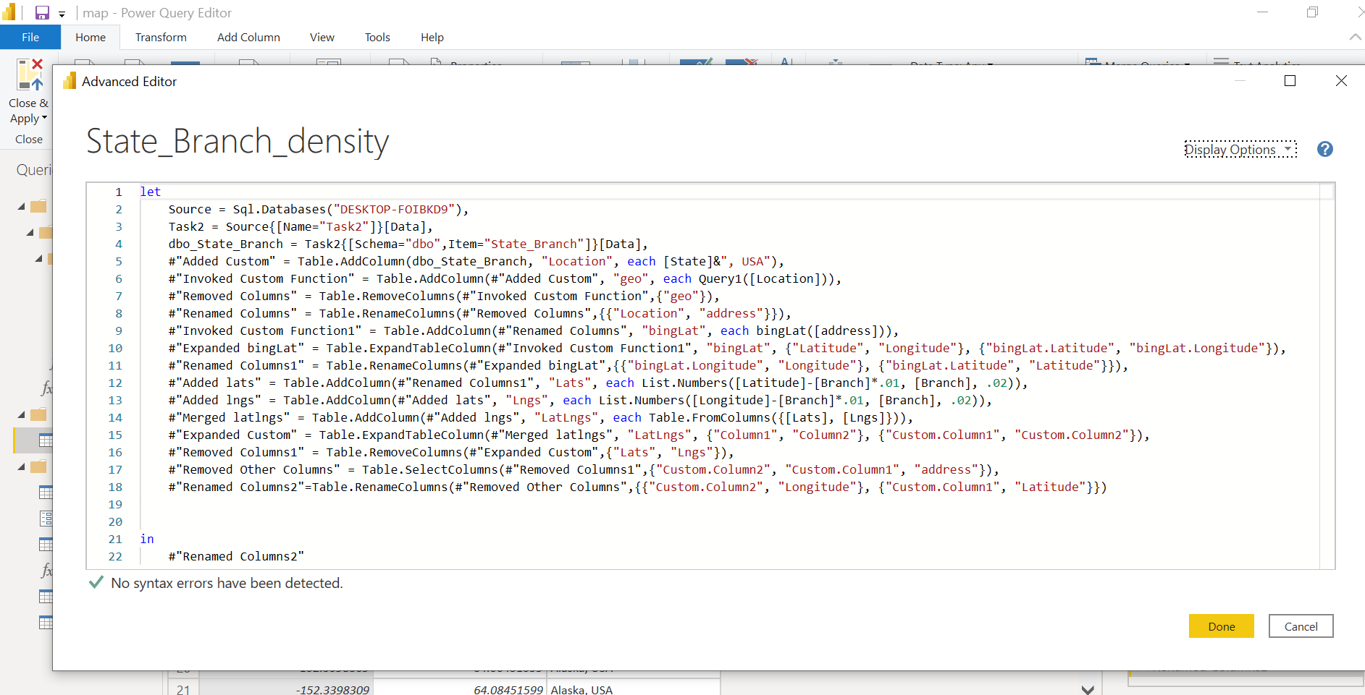
Power Query
M formula language

Slide 15

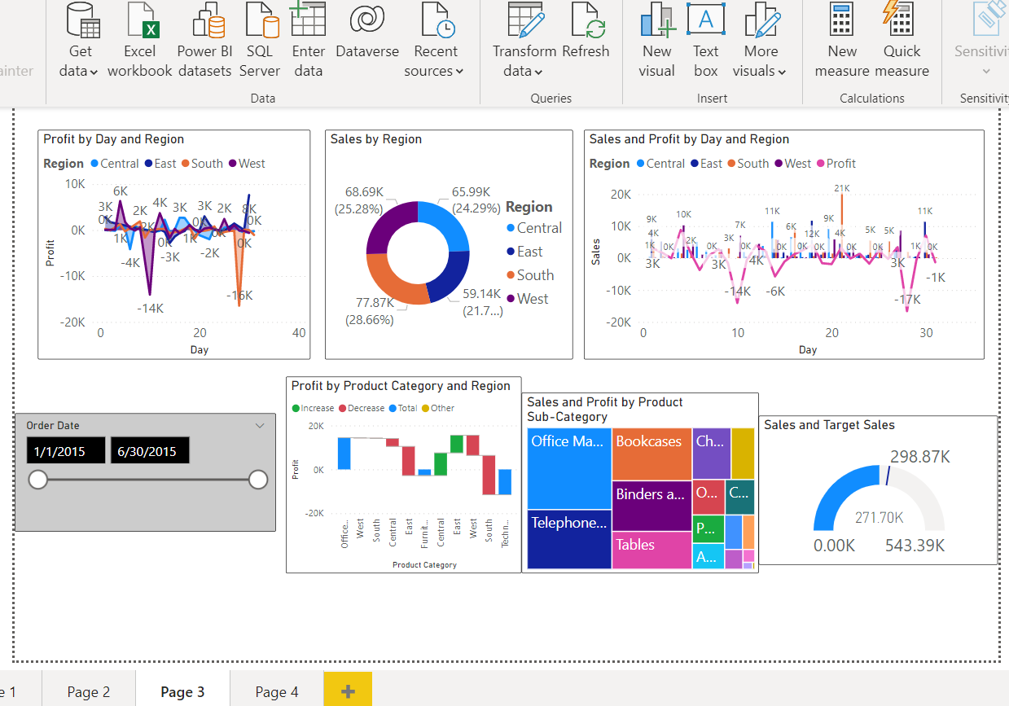
Data Visualization

Slide 16
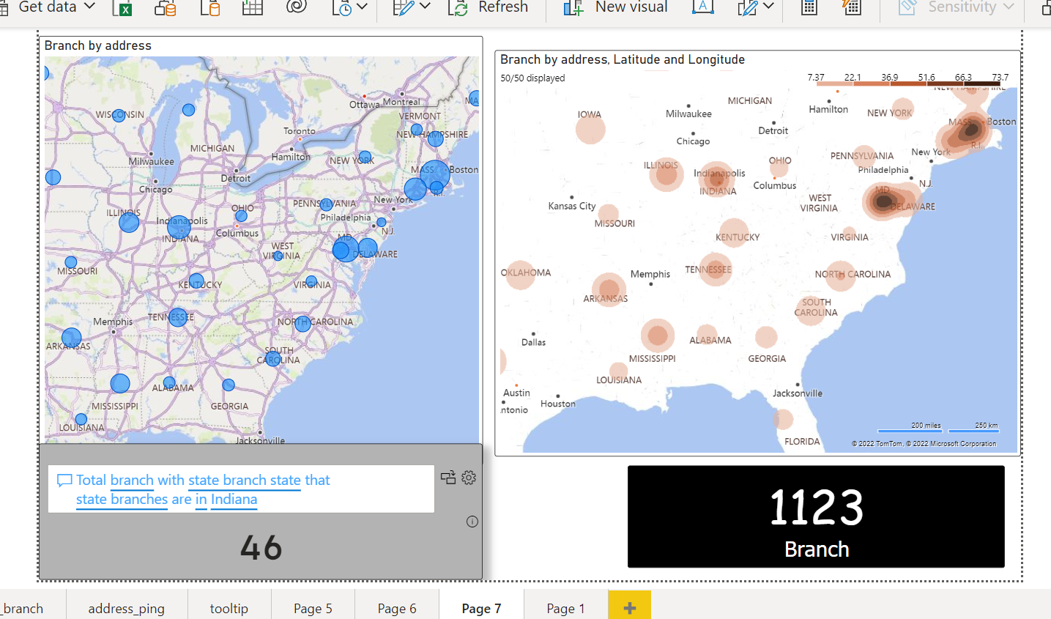
Data Visualization

Slide 17


Soft Skills
Communication skill
Negotiating skill
Teamwork
Self-esteem
Time management

Slide 18

Q & A

Slide 19
Thank you

